Slide 1
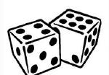
Probability
Probability is the measure of the likelihood that an event will occur. Probability is quantified as a number between 0 and 1 (where 0 indicates impossibility and 1 indicates certainty).

Slide 2

Example
A simple example is the toss of a fair (unbiased) coin. Since the two outcomes are equally probable, the probability of "heads" equals the probability of "tails", so the probability is 1/2 (or 50%) chance of either "heads" or "tails".

Slide 3
Probability Theory
Try to write rules for dental diagnosis using first-order logic, so that we can see how the logical approach breaks down
Consider the following rule:
The problem is that this rule is wrong. Not all patients with toothaches have cavities; some of them have gum disease, an abscess, or one of several other problems:

Slide 4
Unfortunately, in order to make the rule true, we have to add an almost unlimited list of possible causes. We could try turning the rule into a causal rule
But this rule is not right either; not all cavities cause pain The only way to fix the rule is to make it logically exhaustive: to augment the left-hand side with all the qualifications required for a cavity to cause a toothache. Even then, for the purposes of diagnosis, one must also take into account the possibility that the patient might have a toothache and a cavity that are unconnected

Slide 5
Probability Theory: Variables and Events
A random variable can be an observation, outcome or event the value of which is uncertain.
e.g a coin. Let’s use Throw as the random variable denoting the outcome when we toss the coin.
The set of possible outcomes for a random variable is called its domain.
The domain of Throw is {head, tail}
A Boolean random variable has two outcomes.
Cavity has the domain {true, false}
Toothache has the domain {true, false}

Slide 6
Two (toy) examples
I have toothache. What is the cause?
There are many possible causes of an observed event.
If I go to the dentist and he examines me, when the probe catches this indicates there may be a cavity, rather than another cause.
The likelihood of a hypothesised cause will change as additional pieces of evidence arrive.
Bob lives in San Francisco. He has a burglar alarm on his house, which can be triggered by burglars and earthquakes. He has two neighbours, John and Mary, who will call him if the alarm goes off while he is at work, but each is unreliable in their own way. All these sources of uncertainty can be quantified. Mary calls, how likely is it that there has been a burglary?
Using probabilistic reasoning we can calculate how likely a hypothesised cause is.

Slide 7
The connection between toothaches and cavities is just not a logical consequence in either direction.
This is typical of, law, business, design, automobile repair, gardening, dating, and so on.
The agent's knowledge can at best provide only a degree of belief in the relevant sentences.
Our main tool for dealing PROBABILITY THEORY with degrees of belief will be probability theory, which assigns to each sentence a numerical degree of belief between 0 and 1.
We might not know for sure what afflicts a particular patient,
Say, an 80% chance-that is, a probability of 0.8-that the patient has a cavity if he or she has a toothache
The missing 20% summarizes all the other possible causes of toothache that we are too lazy or ignorant to confirm or deny.

Slide 8
The basic element of the language is the random variable, which can be thought of as referring to a "part" of the world whose "status" is initially unknown.
Each random variable has a domain of values that it can take on. For example, the domain of Cavzty might be ( t rue,f a l ~ e

Slide 9
Measures of Central Tendency
Measures of central tendency yield information about “particular places or locations in a group of numbers.”
Common Measures of Location
Mode
Median
Mean
Percentiles
Quartiles

Slide 10
Measures of Central Tendency
Mean … the average score
Median … the value that lies in the middle after ranking all the scores
Mode … the most frequently occurring score

Slide 11
Measures of Central Tendency
The measure you choose should give you a good indication of the typical score in the sample or population.

Slide 12
Measures of Central Tendency
Mean … the most frequently used but is sensitive to extreme scores
e.g. 1 2 3 4 5 6 7 8 9 10
Mean = 5.5 (median = 5.5)
e.g. 1 2 3 4 5 6 7 8 9 20
Mean = 6.5 (median = 5.5)
e.g. 1 2 3 4 5 6 7 8 9 100
Mean = 14.5 (median = 5.5)

Slide 13
Mean (ΜΕΣΟΣ)
Is the average of a group of numbers
Applicable for interval and ratio data, not applicable for nominal or ordinal data
Affected by each value in the data set, including extreme values
Computed by summing all values in the data set and dividing the sum by the number of values in the data set

Slide 14
Population Mean

Slide 15
Measures of Central Tendency
Mode
… does not involve any calculation or ordering of data
… use it when you have categories (e.g. occupation)

Slide 16
Variation or Spread of Distributions
Standard Deviation
It tells us what is happening between the minimum and maximum scores
It tells us how much the scores in the data set vary around the mean
It is useful when we need to compare groups using the same scale

Slide 17
Calculating a Mean and a Standard Deviation

Slide 18
Prior probability
The unconditional or prior probability associated with a proposition a is the degree of belief accorded to it in the absence of any other information.
it is written as P ( a ) .
For example,
If the prior probability that I have a cavity is 0.1, then we would write
P(Cavity = true) = 0.1 or P(cavity) = 0.1 .
It is important to remember that P ( a ) can be used only when there is no other information.
As soon as some new information is known, we must reason with the conditional probability of a given that new information.

Slide 19
Prior probability
Sometimes, we will want to talk about the probabilities of all the possible values of a random variable. In that case, we will use an expression such as P( Weather), which denotes a vector of values for the probabilities of each individual state of the weather.
We can write the four equations
P( Weather = sunny) = 0.7
P( Weather = rain) = 0.2
P( Weather = cloudy) = 0.08
P( Weather = snow) = 0.02 .
we may simply write
P( Weather) = (0.7,0.2,0.08,0.02)
This statement defines a prior probability distribution for the random variable Weather

Slide 20
Probability Theory: Conditional Probability
A conditional probability expresses the likelihood that one event a will occur if b occurs. We denote this as follows
e.g.
So conditional probabilities reflect the fact that some events make other events more (or less) likely
If one event doesn’t affect the likelihood of another event they are said to be independent and therefore
E.g. if you roll a 6 on a die, it doesn’t make it more or less likely that you will roll a 6 on the next throw. The rolls are independent.

Slide 21
Conditional Probability
A conditional probability measures the probability of an event given that (by assumption, presumption, assertion or evidence) another event has occurred.
If the event of interest is A and the event B is known or assumed to have occurred, "the conditional probability of A given B", or "the probability of A under the condition B", For example,
Probability that any given person has a cough on any given day may be only 5%.
But if we know or assume that the person has a cold, then they are much more likely to be coughing.
The conditional probability of coughing given that you have a cold might be a much higher 75%

Slide 22
Conditional Probability
P(A|B) may or may not be equal to P(A) (the unconditional probability of A). If P(A|B) = P(A), then events A and B are said to be independent:.
P(A|B) (the conditional probability of A given B) is not equal to P(B|A).
For example, if a person has dengue they might have a 90% chance of testing positive for dengue. In this case what is being measured is that if event B ("having dengue") has occurred,
the probability of A (test is positive) given that B (having dengue) occurred is 90%: that is, P(A|B) = 90%

Slide 23
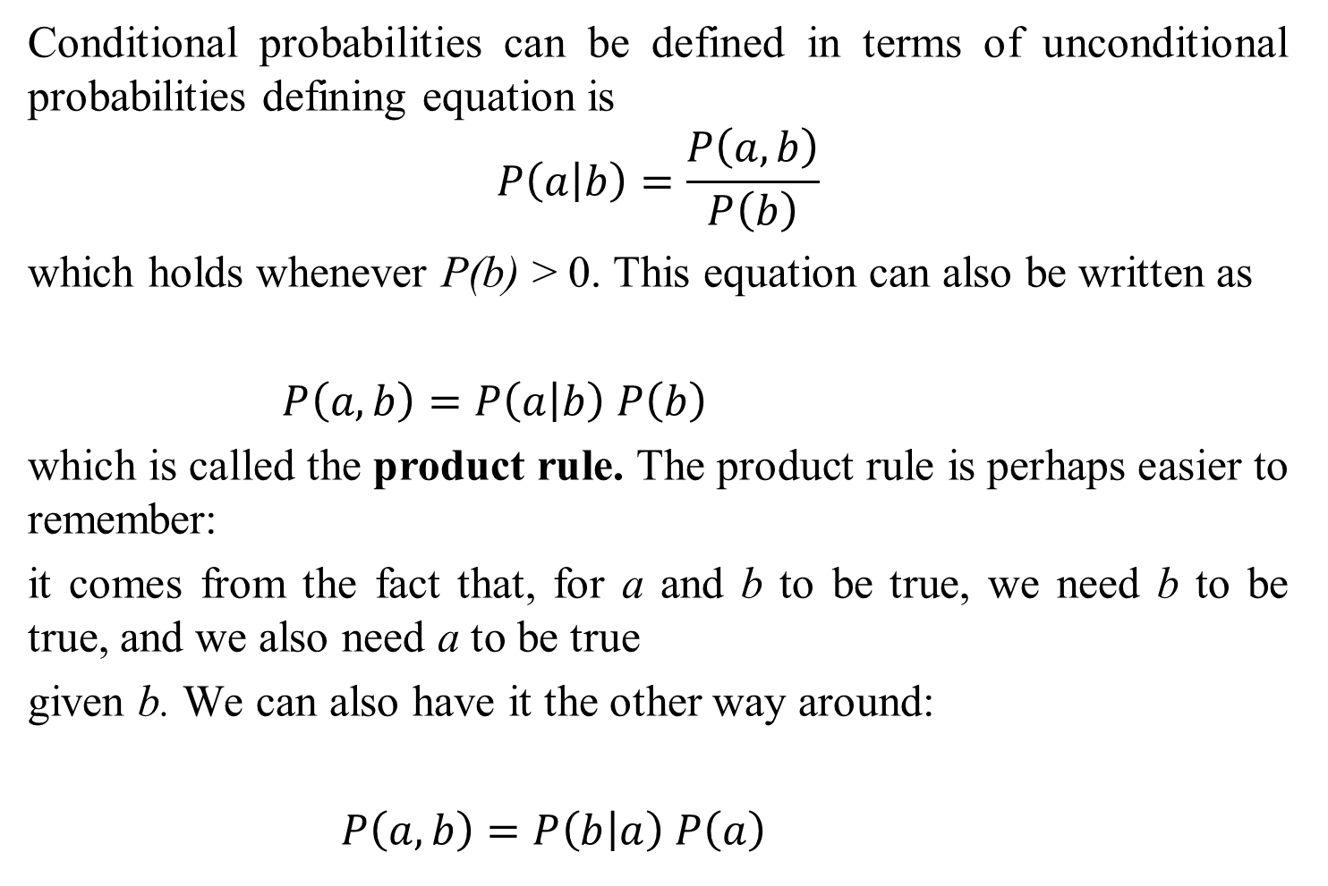
Conditional Probability

Slide 24
Combining Probabilities: the product rule
How we can work out the likelihood of two events occurring together given their base and conditional probabilities?
So in our toy example 1:
But this doesn’t help us answer our question:
“I have toothache. Do I have a cavity?”

Slide 25
KOLMOGOROV'S AXIOMS?
Kolmogorov showed that three simple axioms lead to the rules of probability theory
All probabilities are between 0 and 1:
0 ≤ P(a) ≤ 1
Necessarily true (i.e., valid) propositions have probability 1, and necessarily false 0 P(true) = 1 ; P(false) = 0
Next, we need an axiom that connects the probabilities of logically related propositions. The simplest way disjunction as follows
3. The probability of a disjunction is given by:
P(a ∨ b) = P(a) + P(b) – P(a ∧ b)
b
a
a∧b

Slide 26

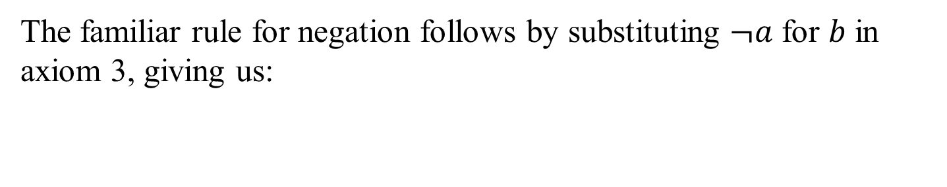
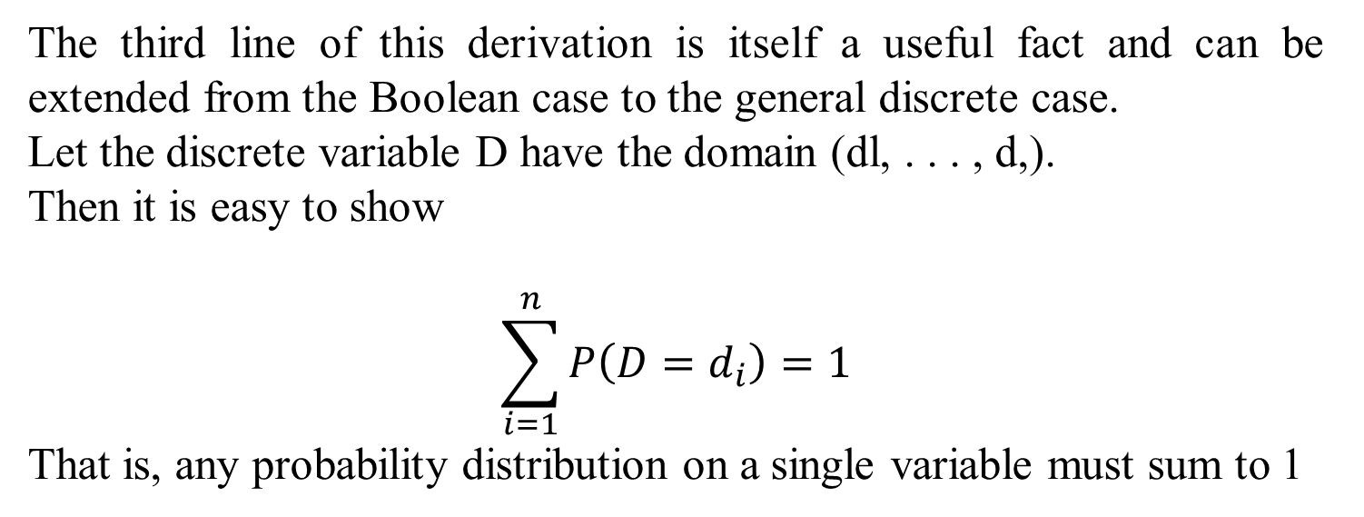
Using the axioms of probability
The familiar rule for negation follows by substituting $¬a$ for $b$ in axiom 3, giving us:
The third line of this derivation is itself a useful fact and can be extended from the Boolean case to the general discrete case.
Let the discrete variable D have the domain (dl, . . . , d,).
Then it is easy to show
$$\sum_{i=1}^{n}{P\left(D=d_{i}\right)=1}$$
That is, any probability distribution on a single variable must sum to 1

Slide 27
Basic Formulas for Probabilities
Product Rule : probability P(AB) of a conjunction of two events A and B:
Sum Rule: probability of a disjunction of two events A and B:
Theorem of Total Probability : if events A1, …., An are mutually exclusive with

Slide 28
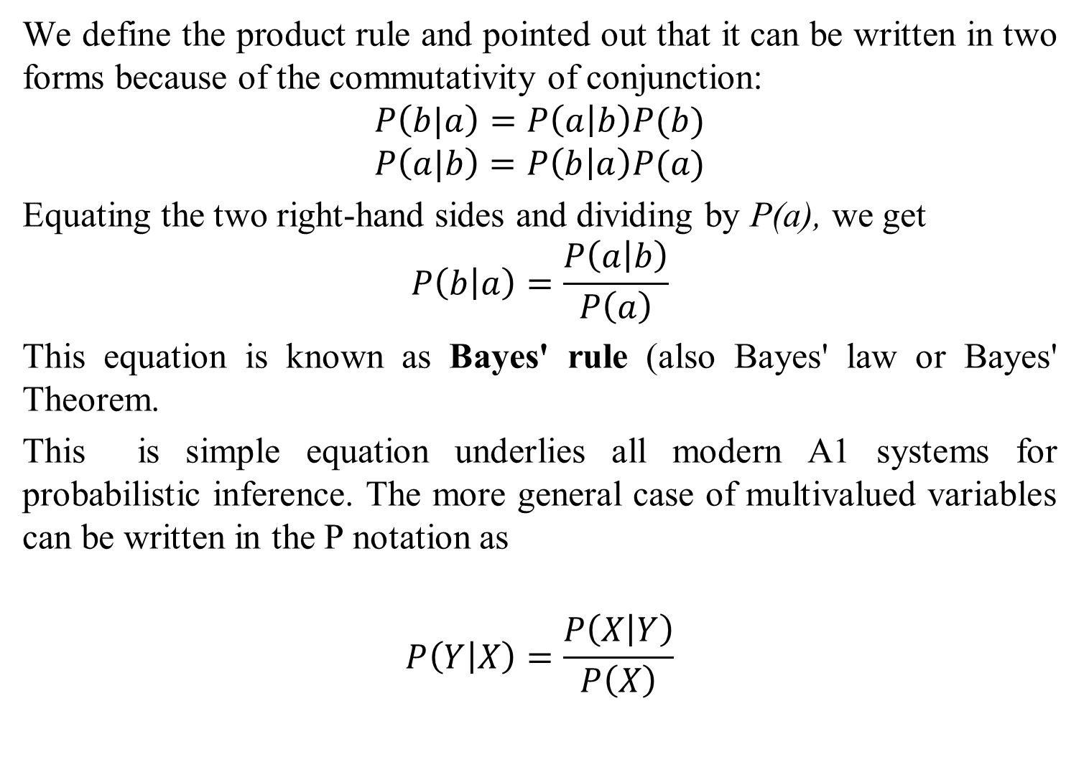
BAYES RULE
We define the product rule and pointed out that it can be written in two forms because of the commutativity of conjunction:
$$P\left(b|a\right)=P\left(a | b\right)P(b)$$
$$P\left(a|b\right)=P\left(b | a\right)P(a)$$
Equating the two right-hand sides and dividing by P(a), we get
$$P\left(b | a\right)=\frac{P\left(a | b\right)}{P\left(a\right)}$$
This equation is known as Bayes' rule (also Bayes' law or Bayes' Theorem.
This is simple equation underlies all modern A1 systems for probabilistic inference. The more general case of multivalued variables can be written in the P notation as
$$P\left(Y | X\right)=\frac{P\left(X | Y\right)}{P\left(X\right)}$$

Slide 29
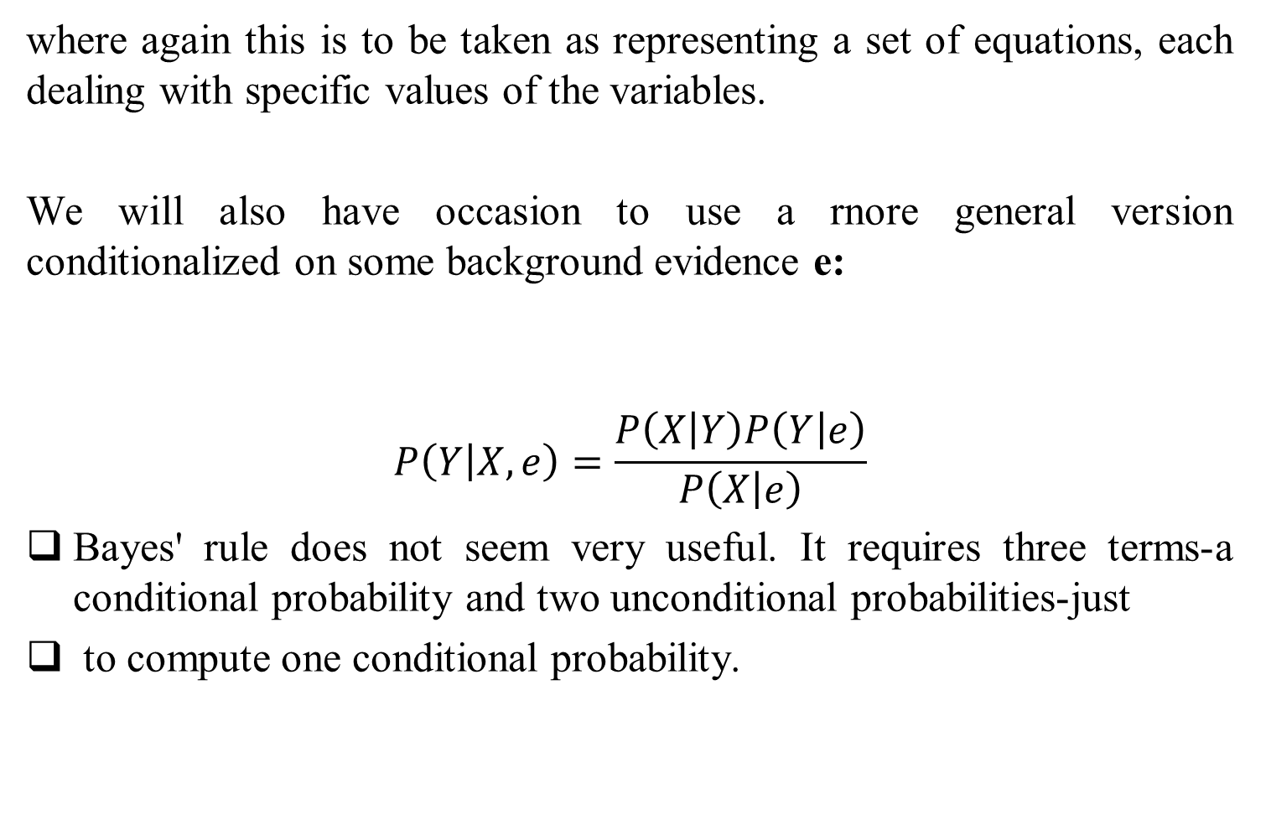
BAYES RULE
where again this is to be taken as representing a set of equations, each dealing with specific values of the variables.
We will also have occasion to use a rnore general version conditionalized on some background evidence e:
$$P\left(Y | X,e\right)=\frac{P\left(X | Y\right)P\left(Y | e\right)}{P\left(X | e\right)}$$
Bayes' rule does not seem very useful. It requires three terms-a conditional probability and two unconditional probabilities-just
to compute one conditional probability.

Slide 30
Bayes’ rule
We can rearrange the two parts of the product rule:
This is known as Bayes’ rule.
It is the cornerstone of modern probabilistic AI.
But why is it useful?

Slide 31
Bayes’ rule
We can think about some events as being “hidden” causes: not necessarily directly observed (e.g. a cavity).
If we model how likely observable effects are given hidden causes (how likely toothache is given a cavity)
Then Bayes’ rule allows us to use that model to infer the likelihood of the hidden cause (and thus answer our question)
In fact good models of are often available to us in real domains (e.g. medical diagnosis)

Slide 32
BAYES RULE
The Bayes Theorem was developed and named for Thomas Bayes(1702-1761)
 Show the Relation between one conditional probability and its inverse.
 Provide a mathematical rule for revising an estimate or forecast in light of experience and observation.
In the 18th Century , Thomas Bayes,
➢ Ponder this question:
“Does God really exist?”
•Being interested in the mathematics, he attempt to develop a formula to arrive at the probability that God does exist based on
the evidence that was available to him on earth.
Later, Laplace refined Bayes’ work and gave it the name
“Bayes’ Theorem”.

Slide 33
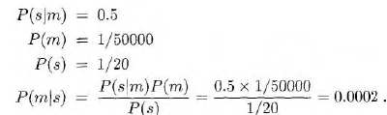
Example-1 BAYES RULE
A doctor knows that the disease meningitis causes the patient to have
a stiff neck, say, 50% of the time. The doctor also knows some unconditional facts: the prior probability that a patient has meningitis is 50,000, and the prior probability that any patient has a stiff neck is 20. Letting s be the proposition that the patient has a stiff neck and m be the proposition that the patient has meningitis, we have
That is, we expect only 1 in 5000 patients with a stiff neck to have meningitis

Slide 34
Bayes’ rule can capture causal models
Suppose a doctor knows that a meningitis causes a stiff neck in 50% of cases
She also knows that the probability in the general population of someone having a stiff neck at any time is 1/20
She also has to know the incidence of meningitis in the population (1/50,000)
Using Bayes’ rule she can calculate the probability the patient has meningitis:

Slide 35
Example-2 of Bayes Rule
Marie is getting married tomorrow, at an outdoor ceremony in the desert. In recent years, it has rained only 5 days each year. Unfortunately, the weatherman has predicted rain for tomorrow. When it actually rains, the weatherman correctly forecasts rain 90% of the time. When it doesn't rain, he incorrectly forecasts rain 10% of the time. What is the probability that it will rain on the day of Marie's wedding?
Solution…
The sample space is defined by two mutually-exclusive events - it rains or it does not rain. Additionally, a third event occurs when the weatherman predicts rain. Notation for these events appears below.
➢ Event A1. It rains on Marie's wedding.
➢ Event A2. It does not rain on Marie's wedding.
➢ Event B. The weatherman predicts rain

Slide 36
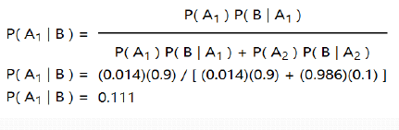
In terms of probabilities, we know the following:
➢ P( A1 ) = 5/365 =0.0136985 [It rains 5 days out of the year.]
➢ P( A2 ) = 360/365 = 0.9863014 [It does not rain 360 days out
of the year.]
➢ P( B | A1 ) = 0.9 [When it rains, the weatherman predicts rain
90% of the time.]
➢ P( B | A2 ) = 0.1 [When it does not rain, the weatherman
predicts rain 10% of the time.]
We want to know P( A1 | B ), the probability it will rain
on the day of Marie's wedding, given a forecast for rain
by the weatherman. The answer can be determined
from Bayes' theorem, as shown below.

Slide 37
Joint Probability Mass Function
Completely specifies all beliefs in a problem domain.
Joint prob Distribution is an n-dimensional table with a probability in each cell of that state occurring.
Written as P(X₁, X₂, X₃ …, X_{n})
When instantiated as P(x₁,x₂ …, x_{n})

Slide 38
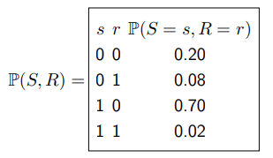
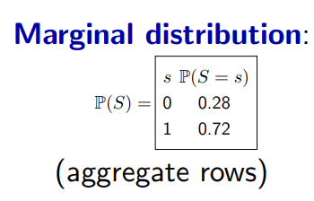
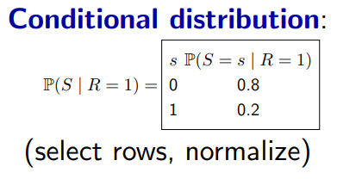
Random variables: sunshine S ∈ {0, 1}, rain R ∈ {0, 1}
Joint distribution:

Slide 39
Suppose we have two boolean random variables, S and R representing sunshine and rain. Think of an assignment to (S, R) as representing a possible state of the world.
The joint distribution specifies a probability for each assignment to (S, R) (state of the world).
We use lowercase letters (e.g., s and r) to denote values and uppercase letters (e.g., S and R) to denote random variables.
Note that P(S = s, R = r) is a probability (a number) while P(S, R) is a distribution (a table of probabilities).
We don’t know what state of the world we’re in, but we know what the probabilities are (there are no unknown unknowns).
The joint distribution contains all the information and acts as the central source of truth

Slide 40
The conditional distribution selects rows of the table matching the condition (right of the bar), and then normalizes the probabilities so that they sum to 1. The interpretation is that we observe the condition (R = 1) and are interested in S. This is the conditioning that we saw for factor graphs, but where we normalize the selected rows to get probabilities

Slide 41
What is a Bayesian Network ?
A graphical model that efficiently encodes the joint probability distribution for a large set of variables

Slide 42
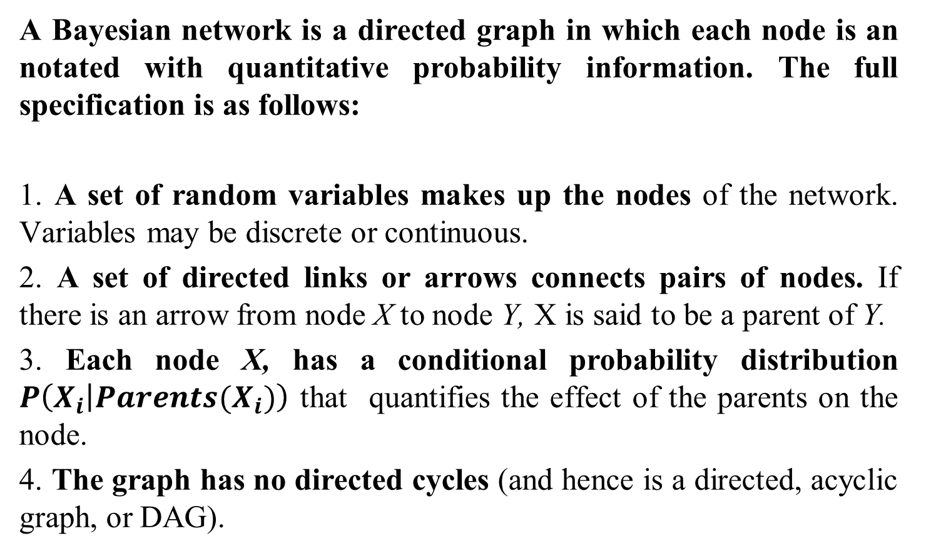
Bayesian network Or Belief Networks
A Bayesian network is a directed graph in which each node is an notated with quantitative probability information. The full specification is as follows:
1. A set of random variables makes up the nodes of the network. Variables may be discrete or continuous.
2. A set of directed links or arrows connects pairs of nodes. If there is an arrow from node X to node Y, X is said to be a parent of Y.
3. Each node X, has a conditional probability distribution $P\left(X_{i} | Parents(X_{i})\right)$ that quantifies the effect of the parents on the node.
4. The graph has no directed cycles (and hence is a directed, acyclic graph, or DAG).

Slide 43
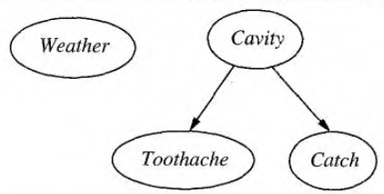
Bayesian network
Conditional independence of Toothache and Catch given Cavity is indicated by the absence of a link between Toothache and Catch.
Intuitively, the network represents the fact that Cavity is a direct cause of Toothache and Catch, whereas no direct causal relationship exists between Toothache and Catch.
Figure 14.1 A simple Bayesian network in which Weather is independent of the other three variables and Toothache and Catch are conditionally independent, given Cavity

Slide 44

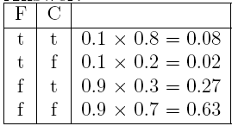
Bayesian Networks
1) Consider the following Bayesian network, where F = having the flu and C = coughing:
a) Write down the joint probability table specified by the Bayesian network.
Answer:

Slide 45

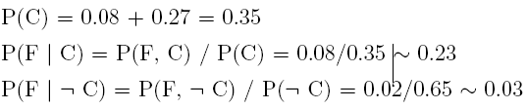
b) Determine the probabilities for the following Bayesian network
so that it specifies the same joint probabilities as the given one.
Answer:

Slide 46
C) Which Bayesian network would you have specified using the rules learned in class?
Answer:
The first one. It is good practice to add nodes that correspond to causes before nodes that correspond to their effects.
d) Are C and F independent in the given Bayesian network?
Answer:
No, since (for example) P(F) = 0.1 but P(F / C) 0.23
e) Are C and F independent in the Bayesian network from Question b?
Answer:
No, for the same reason.

Slide 47
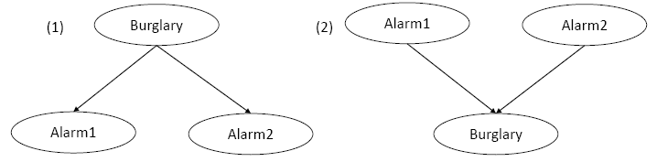
2) To safeguard your house, you recently installed two deferent alarm systems by two deferent reputable manufacturers that use completely deferent sensors for their alarm systems.
a) Which one of the two Bayesian networks given below makes independence assumptions that are not true? Explain all of your reasoning. Alarm1 means that the first alarm system rings, Alarm2 means that the second alarm system rings, and Burglary means that a burglary is in progress.
Answer: The second one falsely assumes that Alarm1 and Alarm2 are independent if the value of Burglary is unknown. However, if the alarms are working as intended, it should be more likely that Alarm1 rings if Alarm2 rings (that is, they should not be independent).

Slide 48
2) To safeguard your house, you recently installed two deferent alarm systems by two deferent reputable manufacturers that use completely deferent sensors for their alarm systems.
b) Consider the first Bayesian network. How many probabilities need to be specified for its conditional probability tables? How many probabilities would need to be given if the same joint probability distribution were specified in a joint probability table?

Slide 49
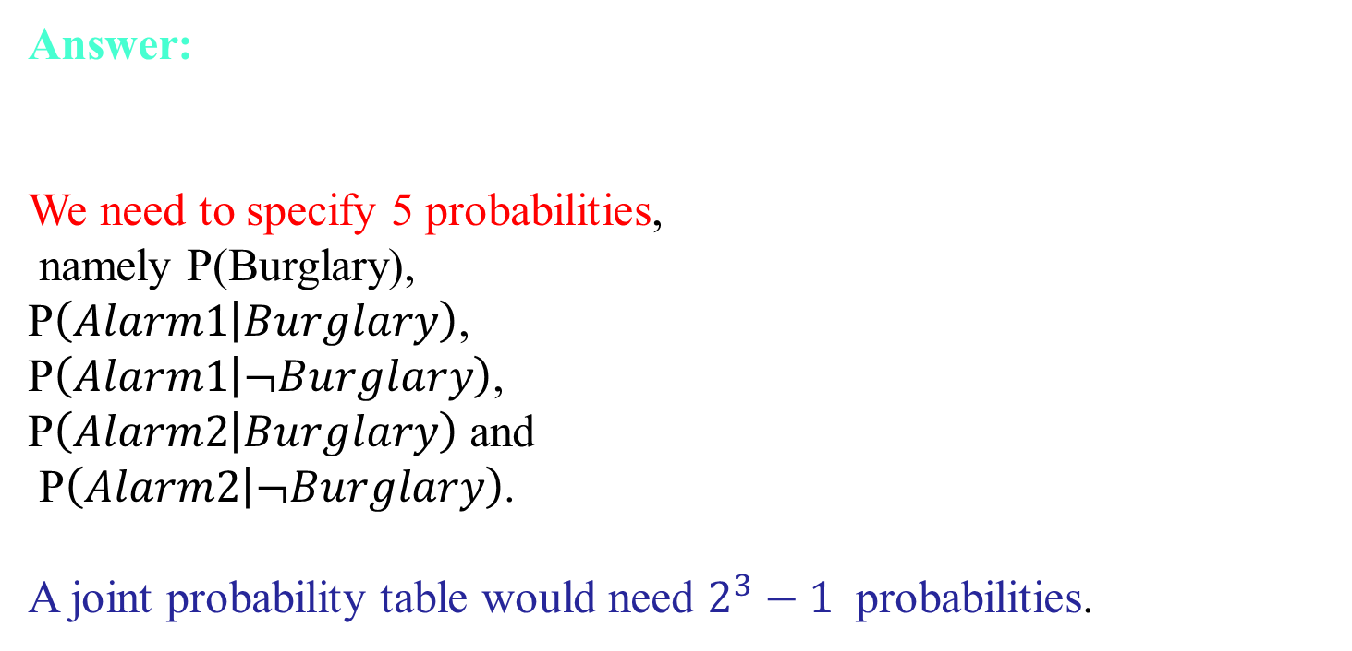
Answer:
We need to specify 5 probabilities,
namely P(Burglary),
P$\left(Alarm1 | Burglary\right)$,
P$\left(Alarm1 | ¬Burglary\right)$,
P$\left(Alarm2 | Burglary\right)$ and
P$\left(Alarm2 | ¬Burglary\right)$.
A joint probability table would need $2^{3}−1$ probabilities.

Slide 50
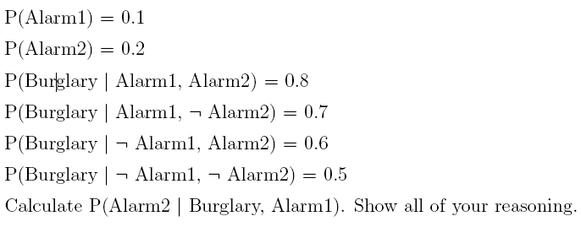
c) Consider the second Bayesian network. Assume that:

Slide 51
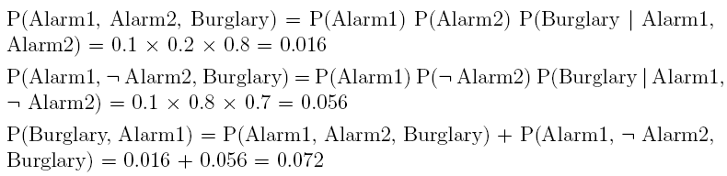
Answer:
with

Slide 52
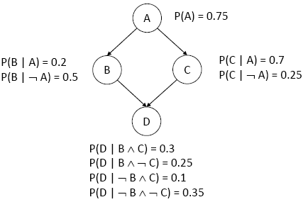
4) Consider the following Bayesian network. A, B, C, and D are Boolean random variables. If we know that A is true, what is the probability of D being true?

Slide 53
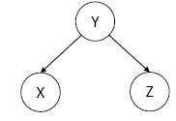
5) For the following Bayesian network
We know that X and Z are not guaranteed to be independent if the value of Y is unknown.
This means that, depending on the probabilities, X and Z can be independent or dependent if the value of Y is unknown.
Construct probabilities where X and Z are independent if the value of Y is unknown, and show that they are indeed independent.

Slide 54
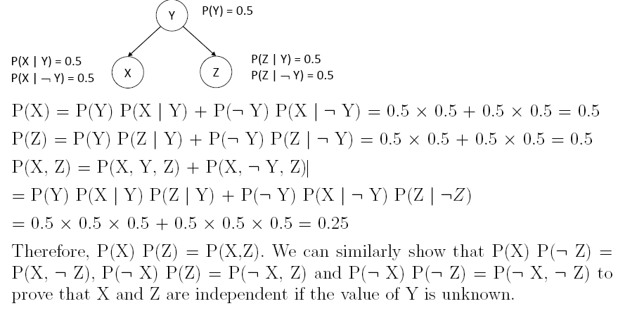

Slide 55
Bayesian network earthquake example
You have a new burglar alarm installed
It is reliable about detecting burglary, but responds to minor earthquakes
Two neighbors (John, Mary) promise to call you at work when they hear the alarm
John always calls when hears alarm, but confuses alarm with phone ringing (and calls then also)
Mary likes loud music and sometimes misses alarm!
Given evidence about who has and hasn’t called, estimate the probability of a burglary

Slide 56
Bayesian network Another Example
or has not called, we would like to estimate the probability of a burglary. The Bayesian network for this domain appears in Figure 14.2.

Slide 57
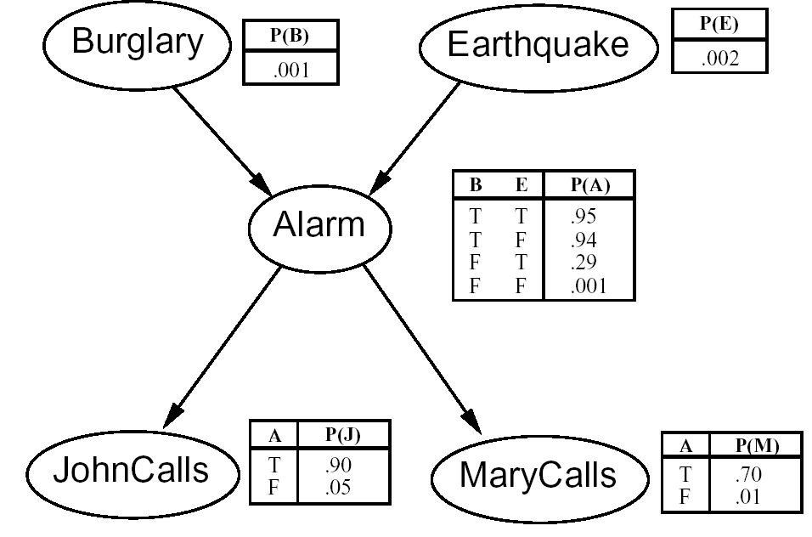
The network
I´m at work, John calls to say my alarm is ringing, Mary doesn´t call. Is there a burglary?
5 Variables
network topol-ogy reflects causal knowledge
In the CPTs, the letters B, E, A, J, and M stand for Burglary, Earthquake, Alarm, JohnCalls, and MarCalls respectively.

Slide 58
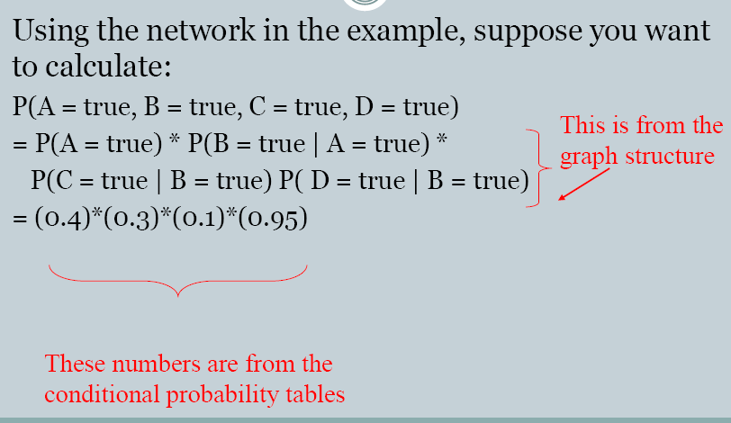
Calculations on the belief network

Slide 59
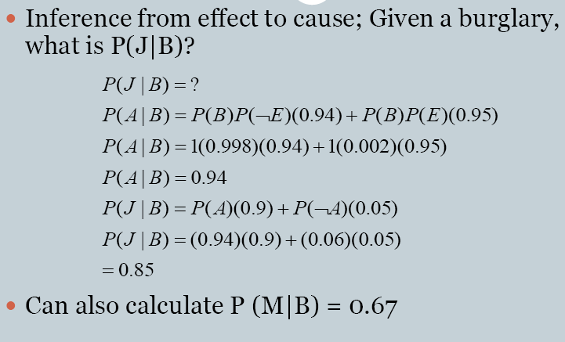
So let’s see how you can calculate P(John called) if there was a burglary?

Slide 60
Why Bayesian Networks?
Bayesian Probability represents the degree of belief in that event while Classical Probability (or frequents approach) deals with true or physical probability of an event
•Bayesian Network
•Handling of Incomplete or missing Data Sets
•Over-fitting of data can is avoidable when using Bayesian networks and Bayesian statistical methods.

Slide 61
Limitations of Bayesian Networks
Typically require initial knowledge of many probabilities…quality and extent of prior knowledge play an important role
Significant computational cost(NP hard task)
Unanticipated probability of an event is not taken care of.

Slide 62
Decision Network
Decision making under uncertainty
Expected utility
Utility theory and rationality
Utility functions
Decision networks
Value of information

Slide 63
Uncertain Outcome of Actions
Some actions may have uncertain outcomes
Action: spend $10 to buy a lottery which pays $10,000 to the winner
Outcome: {win, not-win}
Each outcome is associated with some merit (utility)
Win: gain $9990
Not-win: lose $10
There is a probability distribution associated with the outcomes of this action (0.0001, 0.9999).
Should I take this action?

Slide 64
Expected Utility
Random variable X with n values x₁,…,x_{n} and distribution (p₁,…,p_{n})
X is the outcome of performing action A (i.e., the state reached after A is taken)
Function U of X
U is a mapping from states to numerical utilities (values)
The expected utility of performing action A is EU[A] = Σ_{i=1,…,n} p(x_{i}|A)U(x_{i})
Probability of each outcome
Utility of each outcome

Slide 65
MEU Principle
Decision theory: A rational agent should choose the action that maximizes the agent’s expected utility
Maximizing expected utility (MEU) is a normative criterion for rational choices of actions
Must have complete model of:
Actions
Utilities
States
Notes:
סוכן שה utility שלו מוגדרת בהתאמה לperfrmance measure - מדד הביצועים של הסוכן – אשר ינסה למקסם את תוחלת התועלת ימקסם גם את תוחללת מדד הביצועים ( המיצוע על סביבות שונות)
עיקרון MEU הוא עיקרון נורמצטיבי. הוא מתאר כיצד סוכן רציונלי אמור להתנהג.
זה אינו מודל תיאורי – איך סוכנים אמיתיים – למשל בני אדם – מתנהגים. מחקרים רבים מראים שלאנשים יש הטיות התנהגותיות רבות (דן אריאלי, כהנמן טברסקי..) למשל
A : 80% ל זכות ב 4000 B: 100% לזכות ב 3000. רוב האנשים יבחרו באפשרות A. (העדפת הוודאי)
C : 20% ל זכות ב 4000 B: 25% לזכות ב 3000. רוב האנשים יבחרו באפשרות C. (בחירת EMV(
דוגמא נוספת: פרדוקס Ellsberg : כאן הסכומים קבועים אך לא ההסתברויות: יש לקחת כדור מסל. בסל יש 1/3 אדומים, ו2/3 שחורים וצהובים (יחד) אך לא ידוע כמה מכל אחד.
A: 100 עבור כדור אדום
B 100 עבור כדור שחור
C: 100 עבור כדור אדום או צהוב
D: 100 עבור שחור או צהוב
אם מישהו סבור שיש יותר אדומם משחורים אזי יעדיף A על B ו C על D . אבל רוב האנשים מעדיפים A על B ו D על C.

Slide 66
Decision networks
Extend Bayes nets to handle actions and utilities
a.k.a. influence diagrams
Make use of Bayes net inference
Useful application: Value of Information

Slide 67
Decision Networks
A decision network is a graphical representation of a finite sequential decision problem.
A decision network is an extension of the Bayes' Net representation that allows us to calculated expected utilities for the actions that we take.

Slide 68
Decision network representation
Chance nodes: random variables, as in Bayes nets
Decision nodes: actions that decision maker can take
Utility/value nodes: the utility of the outcome state.

Slide 69
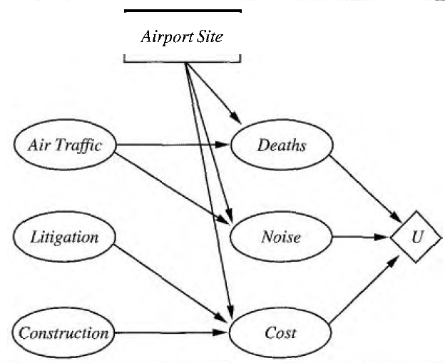
Decision Networks
Decision networks combine Bayesian networks with additional node types for actions and utilities. We, will use airport siting as an example.
Figure 16.5 A simple decision network for the airport-siting problem

Slide 70
Representing a decision problem with a decision network
Decision network represents information about the agent's current state, its possible actions, the state that will result from the agent's action, and the utility of that state.
Chance nodes (ovals) represent random variables, just as they do in Bayes nets.
The agent could be uncertain about the construction cost, the level of air traffic and the potential for litigation, and the Deaths, Noise, and total Cost variables, each of which also depends on the site chosen.
Decision nodes (rectangles) represent points where the decision-maker has a choice of actions. In this case, the Airport site action can take on a different value for each site under consideration. The choice influences the cost, safety, and noise that will result.

Slide 71
Utility nodes (diamonds) represent the agent's utility function .
The utility node has as parents all variables describing the outcome that directly affect utility.
Associated with the utility node is a description of the agent's utility as a function of the parent attributes.
The description could be just a tabulation of the function, or it might be a parameterized additive or multi linear function.

Slide 72
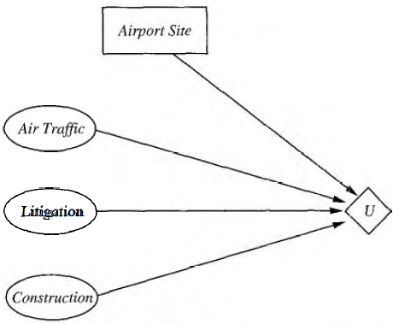
Figure 16.6 A simplified representation of the airport-siting problem. Chance nodes corresponding to outcome states have been factored out.

Slide 73
Evaluating decision networks
Actions are selected by evaluating the decision network for each possible setting of the decision node. Once the decision node is set, it behaves exactly like a chance node that has been set as an evidence variable. The algorithm for evaluating decision networks is the following:
I. Set the evidence variables for the current state.
2. For each possible value of the decision node;
Set the decision node to that value
b) Calculate the posterior probabilities for the parent nodes of the utility node, using a standard probabilistic inference algorithm.
(c) Calculate the resulting utility for the action.
3. Return the action with the highest utility.

Slide 74
Evaluating decision networks
Set the evidence variables for the current state.
For each possible value of the decision node (assume just one):
Set the decision node to that value.
Calculate the posterior probabilities for the parent nodes of the utility node, using BN inference.
Calculate the resulting utility for the action.
Return the action with the highest utility.

Slide 75
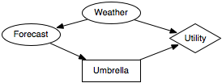
Figure 9.7: Decision network for decision of whether to take an umbrella
Example 9.11: Figure 9.7 shows a simple decision network for a decision of whether the agent should take an umbrella when it goes out. The agent's utility depends on the weather and whether it takes an umbrella. However, it does not get to observe the weather. It only gets to observe the forecast. The forecast probabilistically depends on the weather.

Slide 76
Designer must specify the domain for each random variable and the domain for each decision variable.
Suppose the random variable Weather has domain {norain, rain},
the random variable Forecast has domain {sunny, rainy, cloudy},
Decision variable Umbrella has domain {takeIt, leav eIt}.
There is no domain associated with the utility node.
The designer also must specify the probability of the random variables given their parents.
Suppose P(Weather) is defined by P(Weather=rain)=0.3.

Slide 77
P(Forecast | Weather) is given by
Weather | Forecast | Probability
norain | sunny | 0.7
norain | cloudy | 0.2
norain | rainy | 0.1
rain | sunny | 0.15
rain | cloudy | 0.25
rain | rainy | 0.6
Suppose the utility function, Utility(Weather, Umbrella), is
Weather | Umbrella | Utility
norain | takeIt | 20
norain | leaveIt | 100
rain | takeIt | 70
rain | leaveIt | 0
There is no table specified for the Umbrella decision variable. It is the task of the planner to determine which value of Umbrella to select, depending on the forecast.

